Slide 1
Chapter 1 notes

Slide 2
For your binders- create four tabs. HOMEWORK< DAILY WORK< NOTES< MISCELLANEUS
What did you learn in 7th grade social studies.
Be specific. Write in complete sentences.
This is for a grade.
Write at least 1 paragraph. 5 sentences.

Slide 3
Daily Work
Number 1-3, Answer the following. Use complete sentences please.
Who were the first people in the Americas?
How do we know?
Why is Christopher Columbus said to have discovered the Americas?
You will receive your textbooks today, but you don’t need them to answer the three questions above.

Slide 4
Homework on blue podium
Write a paragraph explaining what you think your responsibilities will be in this class this year.
Be sure to include the material you believe you will learn as well as any class rules and expectations that Mr. Perkins has for you.

Slide 5
Who ate the last Pop Tart?
Aliens

Slide 6
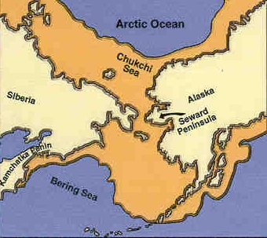
8-22 and 8-23
Explain how people first came to the Americas.
This is to be one of your essays on the test we will take next week. Prepare a good answer using your book be sure it answers who what when where and why.

Slide 7
Come in and get quiet… I will collect these 5 bell ringers soon.
What I learned in 7th grade
Who were the 1st people in the Americas.
Responsibilities this year in my class.
How the 1st people came to the Americas.
How did Farming lead to civilization.

Slide 8
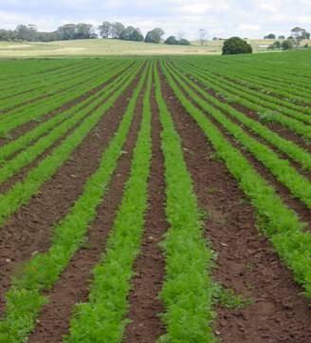
8-26 and 8-29
Explain how farming affected the early Americans.
Why is farming necessary to form large civilizations

Slide 9
Introduction 2
Chapter Objectives
Section 1: Early Peoples
Understand how the first people arrived in the Americas.
Cite the discovery that changed the lives of the early Native Americans.
Click the mouse button or press the Space Bar to display the information.

Slide 10
Introduction 3
Chapter Objectives
Section 2: Cities and Empires
Describe why powerful empires arose in the Americas.
Investigate how the people of each empire adapted to their environment.

Slide 11
Introduction 4
Chapter Objectives
Section 3: North American Peoples
Explore what early people lived in North America.
Examine how different Native American groups adapted to their environments.
Click the mouse button or press the Space Bar to display the information.

Slide 12
Introduction 5
Why It Matters
Thousands of years ago small groups of hunters crossed a bridge of land that connected Siberia and Alaska. Eventually, they spread throughout North and South America.

Slide 13
Introduction 6
The Impact Today
These first people, called Native Americans, influenced later cultures. Native Americans are part of the modern world, yet many of them also preserve the ways of life, customs, and traditions developed by their ancestors centuries ago.

Slide 14
Section 1-1
Guide to Reading
Main Idea
The first Americans spread throughout North, Central, and South America.
Key Terms
archaeology
migration
maize
carbon dating
culture
artifact
Ice Age
nomad
Click the mouse button or press the Space Bar to display the information.

Slide 15
Section 1-2
Guide to Reading (cont.)
Reading Strategy
Determining Cause and Effect As you read Section 1, re-create the diagram shown on page 16 of your textbook and explain why the first Americans came to the continent and the consequences of their arrival.
Read to Learn
how the first people arrived in the Americas.
which discovery changed the lives of the early Native Americans.
Click the mouse button or press the Space Bar to display the information.

Slide 16
Section 1-3
Guide to Reading (cont.)
Section Theme
Geography and History The Ice Age made it possible for hunters to migrate to the Americas.

Slide 17
Section 1-5
The Journey From Asia
The first people migrated from Asia to North, Central, and South America during the last Ice Age.
They reached the Americas thousands of years ago.
This migration took centuries, and people spread out across the Americas as far east as the Atlantic Ocean and as far south as the tip of South America.
(pages 16–18)
Click the mouse button or press the Space Bar to display the information.

Slide 18
Section 1-6
The Journey From Asia (cont.)
These early people crossed a land bridge from Siberia in northeastern Asia to present-day Alaska.
This land bridge, Beringia, now lies under the waters of the Bering Strait.
These early Americans were nomads, moving from place to place in search of food.
These early people were skilled hunters. They used every part of the animal for food, clothing, weapons, and tools.
(pages 16–18)
Click the mouse button or press the Space Bar to display the information.

Slide 19
Section 1-7
The Journey From Asia (cont.)
Why did these early people spread out across the Americas?
Possible answer: They were looking for a particular climate or land terrain as well as enough resources so they could survive.
(pages 16–18)
Click the mouse button or press the Space Bar to display the answer.

Slide 20
Section 1-8
Settling Down
As large animals such as the mammoth disappeared, Native Americans hunted smaller game and ate plants and berries.
Native Americans began to find new food sources by learning to plant and raise crops.
People living near the coast or rivers learned to fish.
Settlers formed villages and communities. Some people remained nomadic hunters.
Early peoples eventually developed their own cultures.
(pages 18–19)
Click the mouse button or press the Space Bar to display the information.

Slide 21
Section 1-9
Settling Down (cont.)
How did early Native Americans learn to adapt to their environment?
They used the resources around them for food, clothing, and shelter. They hunted, fished, planted, and traveled from place to place in search of their needs.
(pages 18–19)
Click the mouse button or press the Space Bar to display the answer.

Slide 22
Section 2-1
Guide to Reading
Main Idea
Several factors led to the rise and decline of great civilizations and empires in the Americas.
Key Terms
civilization
hieroglyphics
terrace
theocracy
Click the mouse button or press the Space Bar to display the information.

Slide 23
Section 2-2
Guide to Reading (cont.)
Reading Strategy
Categorizing Information As you read the section, re-create the diagram on page 22 of your textbook and describe the role religion played in each civilization.
Read to Learn
why powerful empires arose in the Americas.
how the people of each empire adapted to their environment.
Click the mouse button or press the Space Bar to display the information.

Slide 24
Section 2-3
Guide to Reading (cont.)
Section Theme
Culture and Traditions Civilizations such as the Maya, the Aztec, and the Inca arose in present-day Mexico and in Central and South America.

Slide 25
Section 2-5
Early American Civilizations
Several great civilizations arose in present-day Mexico and in Central and South America.
The most advanced (in order they developed) were the Olmec, the Maya, the Aztec, and the Inca. Each thrived for centuries.
The Olmec were first. people lived in what is now Mexico, Guatemala, and Honduras, between 1500 B.C. and 300 B.C.
The Olmec built stone pavements and drainage systems and sculpted large stone monuments. Their civilization influenced their neighbors.
(pages 22–23)
Click the mouse button or press the Space Bar to display the information.

Slide 26
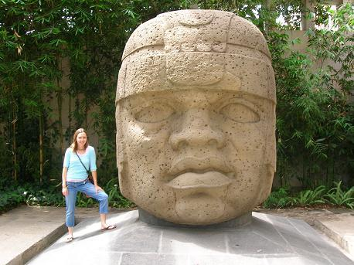
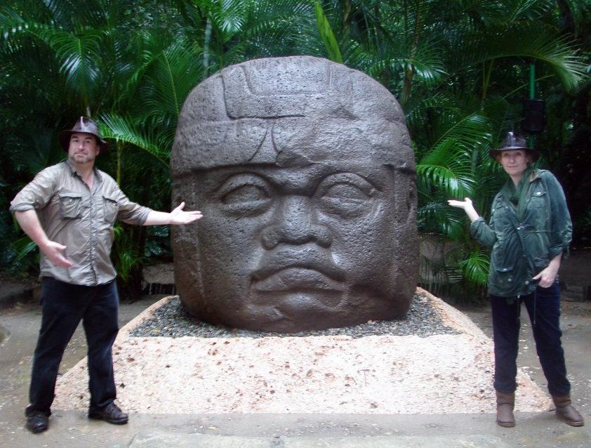

Slide 27
Section 2-6
Early American Civilizations (cont.)
Why do you think early American civilizations developed along large bodies of water?
Possible answer: Early people settled near water as a means of transportation and a way to farm. If they needed to flee quickly, they could navigate along the waters.
(pages 22–23)
Click the mouse button or press the Space Bar to display the answer.

Slide 28
Section 2-7
The Maya
The Mayan civilization flourished in present-day Mexico, Guatemala, Honduras, and Belize.
The people built large cities, each having at least one stone pyramid.
Tikal was the largest Mayan city and had five pyramids.
The Mayan civilization was a theocracy, or a society ruled by religious leaders.
(pages 23–24)
Click the mouse button or press the Space Bar to display the information.

Slide 29
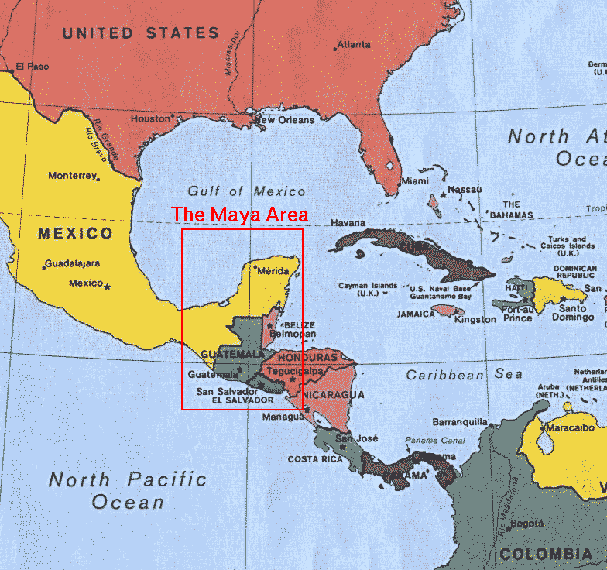

Slide 30
Section 2-8
The Maya (cont.)
The Maya believed that the gods controlled all that happened on Earth.
Atop the pyramids were religious and governmental centers.
The Maya became skilled astronomers and developed a writing system called hieroglyphics.
Mayan traders transported their goods such as maize, vegetables, jade, turquoise jewelry, and cacao beans on their backs and along the water.
(pages 23–24)
Click the mouse button or press the Space Bar to display the information.

Slide 31
Section 2-9
The Maya (cont.)
No one knows what caused the decline of the Maya around A.D. 900, but descendants of the Maya still live in parts of Mexico and Central America.
(pages 23–24)

Slide 32
Section 2-10
The Maya (cont.)
Why do you think the Maya believed that the gods controlled what happened on Earth?
Possible answer: It was an easy way to explain what they did not understand, such as the change of seasons or the weather.
(pages 23–24)
Click the mouse button or press the Space Bar to display the answer.

Slide 33
Section 2-11
The Aztec
Founded in 1325, Tenochtitlán was the Aztec capital city.
Situated on an island, it was one of the largest cities in the Americas.
Workers toiled day and night to make causeways linking the island to the mainland and filling in Lake Texcoco, upon which the city was built.
Tenochtitlán was a center of trade.
The Aztec people were warriors and conquered nearly all rival communities. They built a military empire.
(pages 24–25)
Click the mouse button or press the Space Bar to display the information.

Slide 34
Section 2-12
The Aztec (cont.)
From the conquered people, the Aztec took weapons, maize, cotton cloth, and copper.
The Aztec forced their captives to work as slaves.
The Aztec people also believed in pleasing the gods.
Their society was organized around religion, and they sacrificed thousands of prisoners in religious ceremonies.
(pages 24–25)
Click the mouse button or press the Space Bar to display the information.

Slide 35
Section 2-13
The Aztec (cont.)
How did the Aztec build a military empire?
They went to war and conquered neighboring communities. They stole weapons from the conquered people to help build their empire. They used the conquered people as slaves to help them expand their capital city.
(pages 24–25)
Click the mouse button or press the Space Bar to display the answer.

Slide 36
Section 2-14
The Inca
The Inca Empire developed in the western highlands of South America.
Cuzco, the capital city, was founded around A.D. 1200.
The Inca ruler Pachacuti and his son, Topa Inca, conquered neighboring lands to build their empire.
It was the largest of the early American civilizations. It stretched more than 3,000 miles from present-day Colombia to Argentina and Chile.
(page 26)
Click the mouse button or press the Space Bar to display the information.

Slide 38
Section 2-15
The Inca (cont.)
The population of the Inca Empire at its height was more than nine million people.
The Inca were very advanced.
They built 10,000 miles of paved roads.
Rope bridges crossed canyons and rivers.
They developed a record-keeping system using quipus so that runners could take messages from one part of the empire to another.
The Inca language was Quechua, became the official language of the empire.
They believed their emperor was descended from the Sun God
(page 26)
Click the mouse button or press the Space Bar to display the information.

Slide 39
Section 2-16
The Inca (cont.)
They developed a system of terracing the land by building platforms so that they could plant crops on slopes.
They were also a religious people, worshipping the sun god.
(page 26)
Click the mouse button or press the Space Bar to display the information.

Slide 40
Section 2-17
The Inca (cont.)
Why is the Inca considered a great civilization?
It was the largest of the early civilizations, stretching for about 3,000 miles. The Inca developed paved roads, a common language, a record-keeping system, and terracing for farming.
(page 26)
Click the mouse button or press the Space Bar to display the answer.

Slide 41
Section 3-1
Guide to Reading
Main Idea
Many different cultures lived in North America before the arrival of the Europeans.
Key Terms
pueblo
adobe
federation
drought
Click the mouse button or press the Space Bar to display the information.

Slide 42
Section 3-2
Guide to Reading (cont.)
Reading Strategy
Taking Notes As you read Section 3, re-create the diagram shown on page 28 of your textbook and identify locations and ways of living for each culture.
Read to Learn
what early people lived in North America.
how different Native American groups adapted to their environments.
Click the mouse button or press the Space Bar to display the information.

Slide 43
Section 3-3
Guide to Reading (cont.)
Section Theme
Culture and Traditions Early North Americans developed new societies.

Slide 44
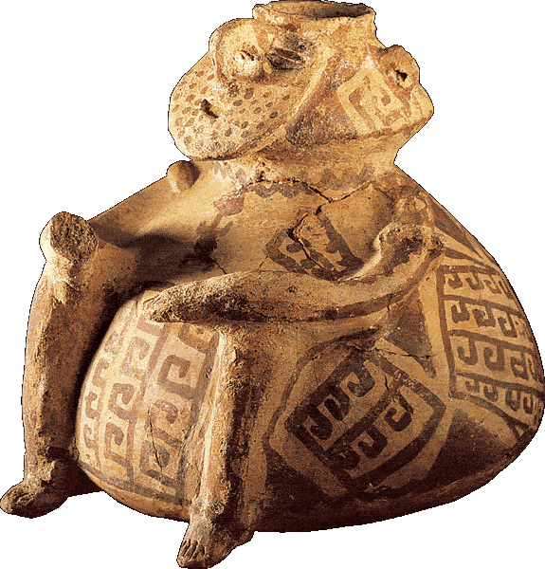
Section 3-4
Ancient jar, American Southwest
Click the Speaker button to replay the audio.

Slide 45
Section 3-5
Early Native Americans
Many Native American cultures existed in North America before Europeans arrived in the 1500s.
The Hohokam lived in the desert of present-day Arizona and flourished from about A.D. 300 to A.D. 1300.
(pages28–31)
Click the mouse button or press the Space Bar to display the information.

Slide 46
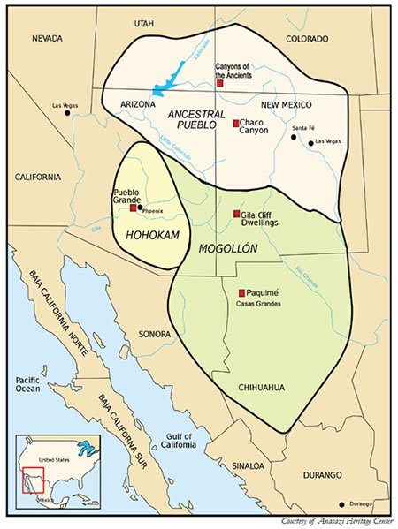

Slide 47
Section 3-6
Early Native Americans (cont.)
They (Hohokam) built irrigation channels to bring water to the hot, dry land from the nearby Gila and Salt Rivers and left behind pottery, carved stone, and shells.
The Anasazi lived in an area known as the Four Corners (or the meeting place) of present-day Utah, Colorado, Arizona, and New Mexico from A.D. 1 to A.D. 1300.
(pages 28–31)
Click the mouse button or press the Space Bar to display the information.

Slide 48
Section 3-7
Early Native Americans (cont.)
The Anasazi built stone and cliff dwellings. A pueblo or stone dwelling looked like an apartment building.
The cliff dwellings were built into the walls of steep cliffs. Pueblo Bonito and Mesa Verde are examples of each.
In about 1300, the Anasazi left these dwellings to settle in smaller communities, perhaps due to droughts during which their crops dried up.
(pages 28–31)
Click the mouse button or press the Space Bar to display the information.

Slide 49
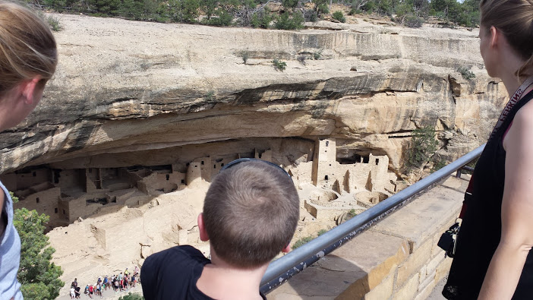

Slide 50
Section 3-8
Early Native Americans (cont.)
The Mound Builders lived in central North America from present-day Pennsylvania to the Mississippi River valley.
They built mounds of earth that looked like the Aztec stone pyramids.
The Adena were hunters and gatherers and among the earliest Mound Builders living in the Ohio Valley around 800 B.C.
(pages 28–31)
Click the mouse button or press the Space Bar to display the information.

Slide 51
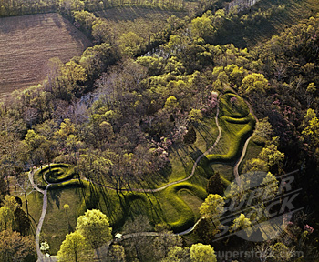

Slide 52
Section 3-9
Early Native Americans (cont.)
The Hopewell people were farmers and traders who built large burial mounds shaped like birds, bears, and snakes.
They left behind pearls, shells, cloth, and copper in the mounds which show their variety of trade.
The Cahokia built the largest settlement in present-day Illinois. This city may have had 16,000 people.
The highest mound, Monks Mound, rose nearly 100 feet and was probably the highest structure north of Mexico.

Slide 53
Section 3-10
Early Native Americans (cont.)
Why do you think the dwellings of these early Native Americans (the pueblos, mounds, and cliff dwellings) were large and massive?
Possible answer: If they reached high in the sky, they would be nearer to the gods. Also, they were visible from far away and could accommodate a large group of people for living quarters and for religious ceremonies.

Slide 54
Section 3-11
Other Native North Americans
The peoples of the North were the Inuit, settling in the cold Arctic region.
Inuits may have been the last to migrate to North America.
They built igloos to protect themselves from severe weather.
They wore furs and sealskins to keep them warm and dry.
They were hunters and fishers.
(pages 31–33)
Click the mouse button or press the Space Bar to display the information.

Slide 55
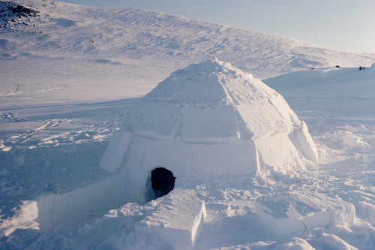
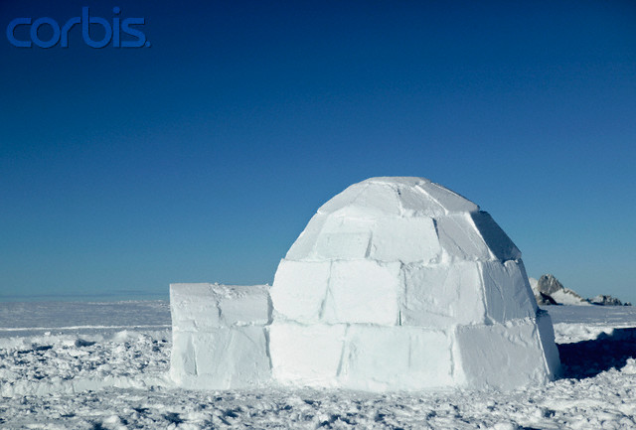

Slide 56
Other Native North Americans (cont.)
The peoples of the West were many: Tlingit, Haida, Chinook, Nez Perce, Yakima, Pomo, Ute, and Shoshone.
They used the resources of the forest and sea as they hunted and gathered.
The Ute and Shoshone created temporary shelters as they traveled to search for food.

Slide 57
Section 3-13
Other Native North Americans (cont.)
The peoples of the Southwest were the Hopi, the Acoma, and the Zuni.
Their homes were made of adobe bricks, and they raised maize, beans, and squash.
The Navajo and the Apache were hunters and gatherers, and built square homes called hogans.
(pages 31–33)
Click the mouse button or press the Space Bar to display the information.

Slide 58
Section 3-14
Other Native North Americans (cont.)
The peoples of the Plains were nomads.
They hunted and farmed and built tents called tepees that they moved with them from place to place.
They learned to tame wild horses and used them to hunt and fight.
(pages 31–33)
Click the mouse button or press the Space Bar to display the information.

Slide 59
Other Native North Americans (cont.)
The peoples of the East, the Iroquois and the Cherokee, formed complex political systems of governing.
The Iroquois formed five groups: the Onondaga, the Seneca, the Mohawk, the Oneida, and the Cayuga.
Until the late 1500s when these groups formed called the Iroquois League, or Iroquois Confederacy, they fought wars with one another.
Click the mouse button or press the Space Bar to display the information.

Slide 60
Other Native North Americans (cont.)
The peoples of the Southeast were the Creek, Chickasaw, and Cherokee. They farmed and adapted to the warmer woodlands climate of the south.

Slide 61
How and why did early peoples come to the Americas?
How did farming allow for the formation of large advanced civilizations?
How did different Native American groups adapt to their environment? Discuss at least 3 groups. (use only groups that exist(ed) in what is now the United States)

Slide 62
Who wrote the Declaration of Independence? Thomas Jefferson.
When was the Declaration of Independence written? July 4th 1776

