Slide 1
Prepare for the test over the colonies… There are 13 of them…
Also
When did Columbus “discover” America?
When was the Declaration of Independence signed?
Who Wrote it?
If you don’t answer the last three correct I am throwing the test away.

Slide 2
Bell ringer list
13 colonies map
Languages, where and why?
Explain how the Spanish Armadas defeat allowed English colonization. 3.1 (beginning)
Compare and contrast the hardships of New England and Virginia (Jamestown)

Slide 3
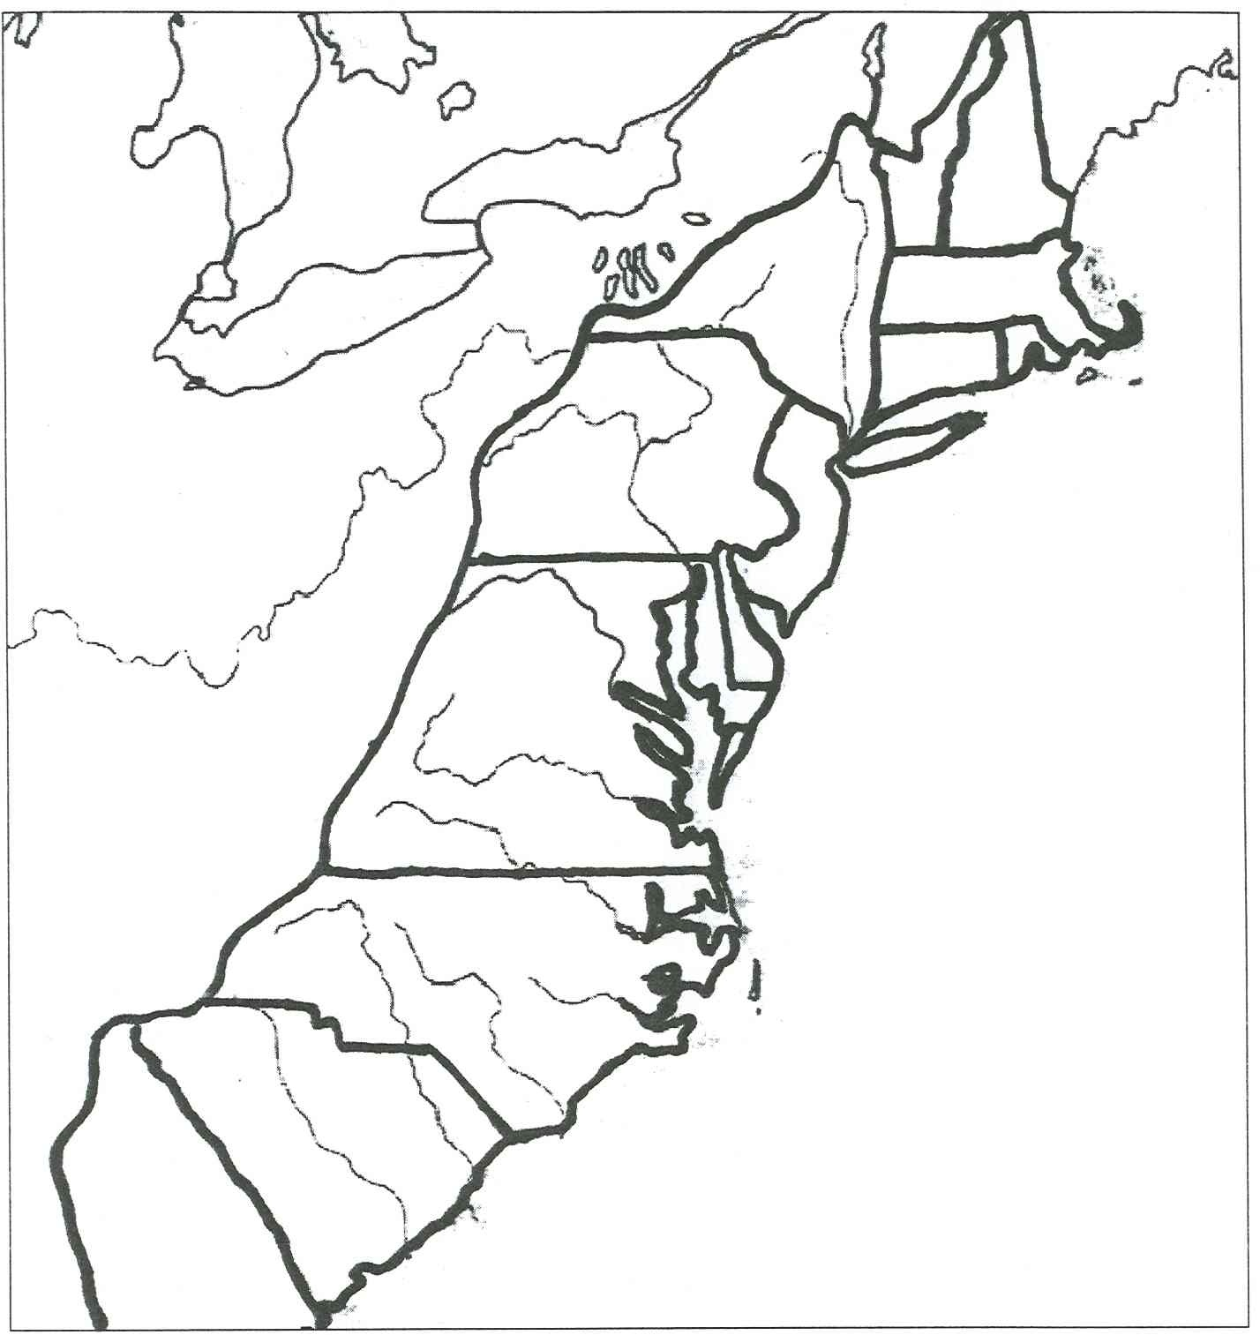
Put Homework on Podium. Grab a map. Label all 13 colonies that we will learn about in chapter 3

Slide 4
Practice the names of these colonies with a partner.
Remember you may have a pop test at any time.

Slide 5
Explain how the defeat of the Spanish Armada allowed the English and other nations to begin colonizing in the Americas.
Be sure to give a description of the Spanish Armada and how it was defeated.

Slide 6
Answer these questions in sentence form.
Be sure to use complete sentences.
What language is spoken most commonly in the United States
Where did this language come from?
Why is it the most common language spoken here?
What language is spoken most commonly in Mexico?
Where did this language come from?
Why is it the most commonly spoken language there?

Slide 7
Explain the similarities and differences in the hardships faced by the English colonists in Virginia and in the New England Colonies.
It may help you to consider factors such as:
Environmental factors (disease, starvation, cold)
Social factors (religion and government)
Native American clashes
Rubric continued on next slide.
3 pts | 2 pts | 1 pt | 0 pts
At least three correct similarities and supporting details | At least 2 correct similarities and supporting details | 1 correct similarity and a supporting detail | 0 similarities or lack of supporting detail
At least 3 accurate differences and supporting detail | 2 correct differences and supporting detail | 1 correct difference and supporting detail | 0 differences or lack of supporting detail
Not copied directly. Easy to read. Contains a main idea. Uses punctuation correctly | Not copied directly. Contains a main idea | Not copied directly. | Plaigerized

Slide 8
Rubric
3 pts | 2 pts | 1 pt | 0 pts
At least three correct similarities and supporting details | At least 2 correct similarities and supporting details | 1 correct similarity and a supporting detail | 0 similarities or lack of supporting detail
At least 3 accurate differences and supporting detail | 2 correct differences and supporting detail | 1 correct difference and supporting detail | 0 differences or lack of supporting detail
Not copied directly. Easy to read. Contains a main idea. Uses punctuation correctly | Not copied directly. Contains a main idea | Not copied directly. | Plaigerized

Slide 9
The English settlers in the new world faced many hardships. Some of the problems they faced were universal. Colonists in Virginia and in Massachusetts faced problems with natives. In Virginia the Natives only began to help the colonists after John Rolfe married Pocahontas and in Massachusetts the colonists fought King Phillips War. Food was hard to come by in both colonies. In Jamestown the winter of 1609 and 1610 was called the starving time. In Massachusetts most of the colonists didn’t know how to support themselves and only found food because of help from Squanto and Samoset. In both colonies there were problems with governing the colonists. In Jamestown the colonists had to form the House of Burgesses in order to effectively govern the colonies. In Massachusetts only white males who owned property had any say in governing the colonies.

Slide 10
There were also hardships that were unique to certain parts of the new world. The climate was different and challenging in both locations. In Jamestown the warm swampy weather was good for tobacco, but also good for mosquitos that carried disease. In Massachusetts the brutal cold winter was tough for the colonists. The colonists faced trouble growing crops but for different reasons. In Jamestown they had no experience growing crops and they were busy looking for gold. In Massachusetts the land was rocky and not good for farming. The leadership of the two colonies presented its own unique set of problems. In Jamestown, everything depended upon John Smith and when he left for England troubles arose. In the New England Colonies, the leaders were very intolerant of other peoples religious beliefs. They forced colonists to leave if they didn’t share each others beliefs. The colonists faced many challenges, but it is how they overcame these obstacles that they became our founding fathers.

Slide 11
Guide to Reading
Main Idea
Jamestown became the first successfully established English colony in North America.
Key Terms
charter A DOCUMENT THAT ALLOWS PEOPLE TO CREATE COLONIES
joint-stock company A COMPANY WHERE INVESTORS BOUGHT STOCK
Burgesses A REPRESENTATIVE
Click the mouse button or press the Space Bar to display the information.

Slide 12
Guide to Reading (cont.)
Reading Strategy
Organizing Information As you read Section 1, re-create the diagram shown on page 70 of your textbook and describe the economy and government of Jamestown.
Jamestown | Description
Economy | Based on Tobacco
Government | A basic form of representation known as the House of Burgesses existed.
Read to Learn
how the colonists received political rights.
what crop saved the people of Jamestown.

Slide 13
Guide to Reading (cont.)
Section Theme
Economic Factors Many settlers journeyed to America with the hope of making a fortune.

Slide 14
England in America
The English defeat of the Spanish Armada ended Spanish control of the seas.
England and other European nations could begin colonies in North America because it was now safe to sail the waters.
In 1583 Sir Humphrey Gilbert claimed Newfoundland for Queen Elizabeth.
Click the mouse button or press the Space Bar to display the information.

Slide 15
England in America (cont.)
Sir Walter Raleigh sent about 100 men to settle on Roanoke Island off the coast of present-day North Carolina in 1585.
After the difficult winter there, the colonists returned to England.

Slide 16
England in America (cont.)
Later a second group of settlers came in 1587.
This group of Roanoke colonists deserted the island and disappeared.
No clues to their fate were left except the word Croatoan carved on a gatepost.

Slide 17
Section 1-8
Jamestown Settlement
In April 1607, settlers sent by the Virginia Company in London entered Chesapeake Bay and founded Jamestown.
They faced many hardships.
For example, they found no gold nor did they establish the fish or fur trading expected of them by the Virginia Company investors.
The number of colonists dwindled. This was called the “Starving Time”
Click the mouse button or press the Space Bar to display the information.

Slide 18
Section 1-9
Jamestown Settlement (cont.)
Captain John Smith governed Jamestown for the first two years.
When Smith returned to England, the lack of strong leadership caused problems.
A harsh winter “The Starving Time” and more trouble continued to plague the colonists.
Click the mouse button or press the Space Bar to display the information.

Slide 19
Jamestown Settlement (cont.)
When John Rolfe showed the colonists how to grow tobacco, the colony began to prosper.
Relations with the Native Americans living nearby also improved when John Rolfe, married Pocahontas, the daughter of Chief Powhatan.

Slide 20
Jamestown Settlement (cont.)
The Virginia Company allowed a representative government in which ten towns in the colony each sent two representatives, or burgesses, to an assembly.
The assembly made local laws.
The House of Burgesses met for the first time on July 30, 1619.
In 1619 ninety women were sent to Jamestown so that families could form and the population could increase.

Slide 21
Jamestown Settlement (cont.)
In 1619 twenty Africans came to Jamestown.
Africans were sold to Jamestown planters to work in the tobacco fields.
They may have come as servants, not as slaves.

Slide 22
Jamestown Settlement (cont.)
Until 1640 some Africans were free and some owned property.
In the years that followed, however, Most Africans came as enslaved passengers or were sold as slaves upon arrival.
Slavery became legal in the 1660s.
Eventually, King James of England canceled its charter (permission to settle) and made Jamestown England’s first royal colony in America.

Slide 23
Guide to Reading
Main Idea
The Northern colonies are called the New England Colonies.
dissent
Pilgrim
Mayflower Compact
toleration
persecute
Puritan
Separatist

Slide 24
Religious Freedom
There were four basic religious ideas in England in the 1600s
Anglicans who were happy with their church.
Catholics who were persecuted by the Anglicans
Anglicans who wanted to reform the Anglican Church were Puritans.
Anglicans who wanted to leave and set up their own church were Separatists.

Slide 25
Anglican means “Church of England”
In America today the Anglican church is called the Episcopal Church.

Slide 26
Religious Freedom (cont.)
Some Separatists fled to the Netherlands for religious freedom.
Some of these Separatists were given a guarantee by the Virginia Company to be able to practice their religion freely if they settled in Virginia.
In return they had to share their profits with the Virginia Company.
These people called themselves Pilgrims.

Slide 27
Religious Freedom (cont.)
The Mayflower carried Pilgrims to settle the Virginia colony.
They landed north, however, at Plymouth, Massachusetts, due to the oncoming winter.
Plymouth was not part of the Virginia Company territory and its laws did not apply.
So the Pilgrims drew up the Mayflower Compact to provide laws to live by.
It was the beginning of a representative government in America.

Slide 28
Religious Freedom (cont.)
The Pilgrims received help from the Native Americans in learning to plant crops and in hunting and fishing. Squanto and Samoset were their names.
The Pilgrims received help from natives including Squanto and Samoset. They taught them how to survive in their environment.

Slide 29
New Settlements
In 1629 a group received a royal charter and formed the Massachusetts Bay Colony located north of Plymouth.
A group or Puritans were forced out of England. They settled in Boston with John Winthrop as their governor.
A group of Puritans were forced out of England. They settled in Boston with John Winthrop as their governor.

Slide 30
New Settlements (cont.)
During the Great Migration in the 1630s, more than 15,000 Puritans came to Massachusetts to escape religious persecution and economic difficulties in England.

Slide 31
New Settlements (cont.)
An elected group called the General Court ran the colony.
The Massachusetts Bay Colony created a colonial legislature when settlers wanted a larger role in government.
All adult male church members who also owned property could vote for their representatives to the General Court.
In every colony there developed some degree of self government

Slide 32
New Settlements (cont.)
Although the Puritans left England for religious freedom in America, they criticized, or persecuted, people who held religious beliefs other than theirs.
This led to the formation of new colonies in America.
Colonists began to settle along the fertile Connecticut River valley in the 1630s.

Slide 33
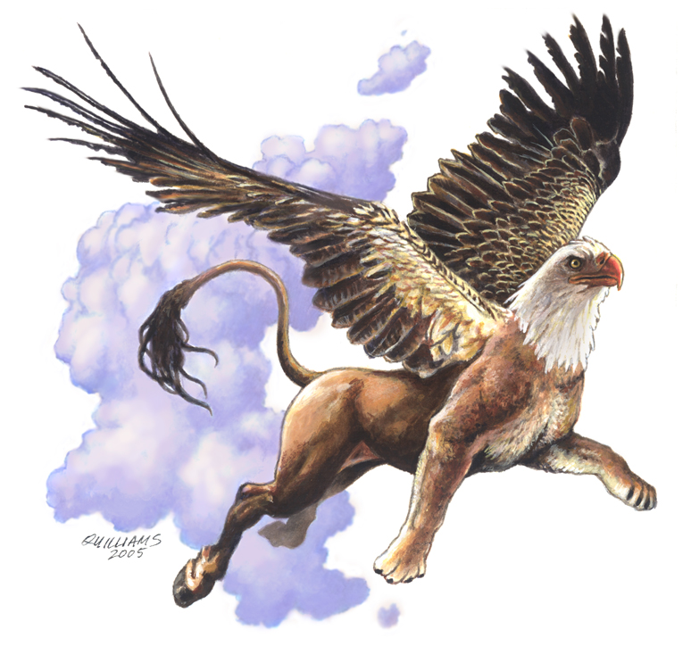
I hate mythical creatures and hypocrites…. Said the hippogriff.

Slide 34
New Settlements (cont.)
In 1636 Thomas Hooker founded Hartford Connecticut.
Three years later, Hartford and two neighboring towns adopted the Fundamental Orders of Connecticut.
This was the first written constitution in America.

Slide 35
New Settlements (cont.)
Roger Williams, a minister, established Rhode Island, where religious toleration existed all faiths could worship.
People of all faiths could worship as they pleased.
In 1638 John Wheelwright founded the colony of New Hampshire. It became independent of Massachusetts in 1679.

Slide 36
Guide to Reading
Main Idea
People from many different countries settled in the Middle Colonies for a variety of reasons, including religious freedom.
Key Terms
patroon
proprietary colony
pacifist

Slide 37
Guide to Reading (cont.)
Reading Strategy
Classifying Information As you read this section, re-create the diagram shown on page 82 of your textbook and describe how the Middle Colonies were founded.
Read to Learn
why the Middle Colonies had the most diverse populations in colonial America.
who was America’s first town planner.

Slide 38
Guide to Reading (cont.)
Section Theme
Individual Action Leaders such as Peter Stuyvesant and William Penn helped the Middle Colonies grow.

Slide 39
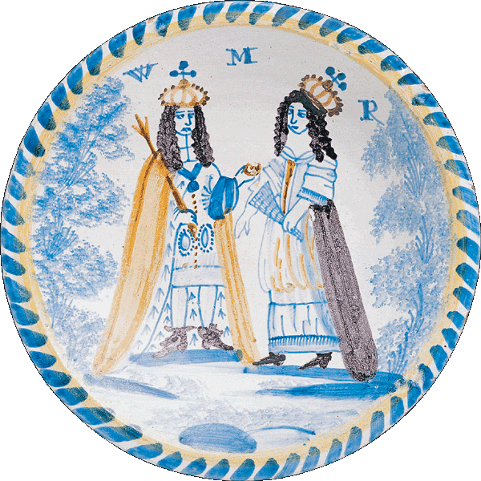
English royal plate

Slide 40
England and the Colonies
In 1660 England had two groups of colonies:
The New England colonies were run by private corporations under a royal charter. They were Massachusetts, New Hampshire, Connecticut, and Rhode Island.
And the royal colonies were run by England. They were Maryland and Virginia.
England wanted to gain control of the Dutch-controlled land (Now New York) in between these two groups of colonies because of its harbor and river trade.
(pages 82–84)

Slide 41
England and the Colonies (cont.)
The Dutch colony was New Netherland.
Its main settlement of New Amsterdam on Manhattan Island was a center of shipping to and from the Americas.
The Dutch West India Company gave new settlers who brought at least 50 settlers with them a large estate.
Dutch landowners gained riverfront estates and ruled like kings. They were called patroons.

Slide 42
England and the Colonies (cont.)
In 1644 the English sent a fleet to attack New Amsterdam.
The governor of New Amsterdam, New Amsterdam’s governor, Peter Stuyvesant, was unprepared for a battle, so he surrendered the colony.

Slide 43
England and the Colonies (cont.)
The English King gave the land to his brother the Duke of York who renamed it New York.
He promised the colonists freedom of religion.
The population of New York grew to about 8,000 in 1664.
New Amsterdam, now called New York City, became one of the fastest-growing cities.

Slide 44
England and the Colonies (cont.)
The southern part of New York between the Hudson and the Delaware Rivers became New Jersey.
Its inhabitants were diverse in ethnicity and religion, like those from New York.
Without a major port or city, however, NJ was unsuccessful did not make the money the landowners expected.
By 1702 New Jersey became a royal colony, yet it continued to make local laws.

Slide 45
Pennsylvania
William Penn received a large tract of land in America from the king as a repayment of a debt. The colony was Pennsylvania.
Penn, a Quaker, saw Pennsylvania as a chance to put the Quaker ideas of tolerance and equality into practice.
Quakers have some unusual beliefs:
Pacifists
Inner light that guides to salvation
He designed the city of Philadelphia and wrote the first constitution.

Slide 46
Pennsylvania (cont.)
To encourage settlers to Pennsylvania, he advertised the colony throughout Europe in several languages.
By 1683 more than 3,000 English, Welsh, Irish, Dutch, and German people settled there.
In 1704 the Three Lower Counties of Pennsylvania formed their own legislature and became the colony of Delaware.

Slide 47
Pennsylvania (cont.)
In 1701 Penn granted the colonists the right to elect representatives to a legislative assembly.
In 1704 the Three Lower Counties of Pennsylvania formed their own legislature and became the colony of Delaware.
The counties functioned as a separate colony known as Delaware, and were supervised by Pennsylvania’s governor.

Slide 48
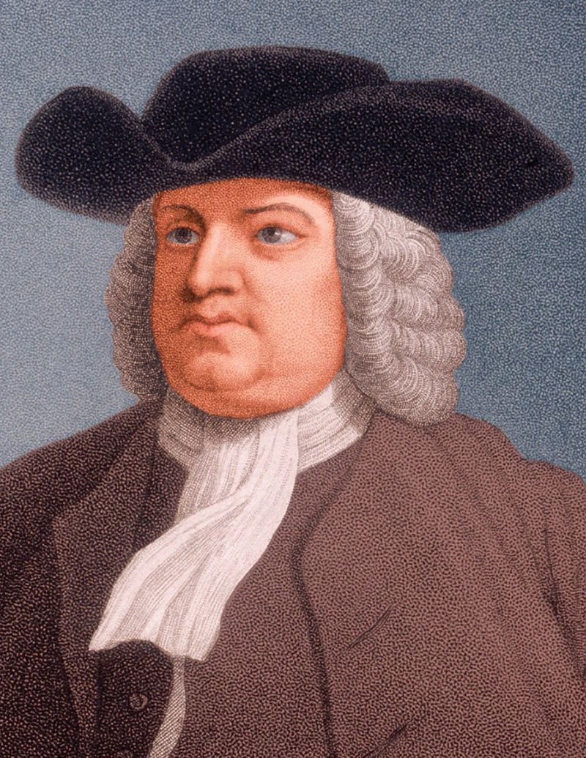
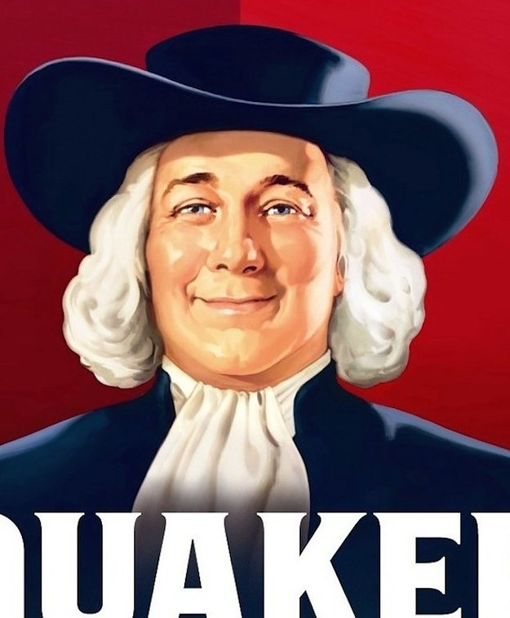

Slide 49
Guide to Reading
Main Idea
The Southern Colonies relied on cash crops to survive, while the French and Spanish tried to establish their own settlements.
Key Terms
indentured servant
tenant farmer
mission
constitution
debtor

Slide 50
Guide to Reading (cont.)
Reading Strategy
Classifying Information As you read this section, re-create the diagram shown on page 86 of your textbook and identify the main crops of three of the Southern Colonies.
Read to Learn
how the Southern Colonies were established.
how French and Spanish colonies differed from the English colonies.

Slide 51
Colony | Main crop
Maryland | Tobacco
North Carolina | Tobacco and Timber
South Carolina | Rice and Indigo

Slide 52
Guide to Reading (cont.)
Section Theme
Groups and Institutions Spanish and French settlements developed in different ways from English settlements.

Slide 53
Coming to America
The colonies needed people to grow and prosper.
Settlers came voluntarily. Others came because they were:
Criminals or prisoners of war from England and Scotland and could earn their release if they worked for a period of time (seven years).
Seized and brought as slaves from Africa.
Indentured servants who worked without pay for a certain period of time in exchange for their passage.
Click the mouse button or press the Space Bar to display the information.

Slide 54
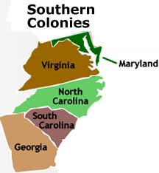

Slide 55
Coming to America (cont.)
Maryland became a proprietary colony in 1632.
King Charles I gave Sir George Calvert, called Lord Baltimore, a colony north of Virginia.
Lord Baltimore wanted to establish a safe place for Catholics, and he also hoped that the colony of Maryland would make him rich. The Land was given to George Calvert but he died. Lord Baltimore was his son Cecil.

Slide 56
Coming to America (cont.)
Maryland’s tobacco farmers grew very wealthy but they also produced wheat, fruit, vegetables, and livestock so that they would not be dependent upon one cash crop.
Wealthy landowners became powerful.
As plantations grew in number, indentured servants and enslaved Africans were used to work the plantations.

Slide 57
Coming to America (cont.)
Baltimore became the largest settlement, founded in 1729.
Because the boundary between Maryland and Pennsylvania was disputed, the British astronomers Mason and Dixon were hired to resolve the issue and establish a boundary.

Slide 58
Coming to America (cont.)
A conflict between Catholics and Protestants, who outnumbered them, resulted in the passage of the Act of Toleration in 1649.
It stated that both groups had the right to worship freely.
Eventually, the Protestant-controlled assembly made the Anglican Church became the official Church in Maryland, and imposed the same restrictions on Catholics that existed in England.

Slide 59
Virginia Expands
As Virginia grew, settlers moved inland in the backcountry of Virginia.
Native Americans lived on these lands.
The governor, Sir William Berkeley, worked out an arrangement with the Natives that in the 1640s that kept settlers from moving onto Native American land.
The settlers received a large piece of land, and conflicts were diminished.

Slide 60
Virginia Expands (cont.)
Many Virginia westerners resented Berkeley’s pledge to the Native Americans and settled in the lands anyway.
As a result, Native Americans raided these settlements.

Slide 61
Virginia Expands (cont.)
Nathaniel Bacon opposed colonial government because it was made of easterners.
He led attacks on Native American villages, set fire to the capital, marched into Jamestown, and drove Berkeley into exile.
Bacon died of an illness shortly afterwards. England summoned Berkeley and sent troops to restore order.

Slide 62
Settling the Carolinas
King Charles II founded the colony of Carolina.
Carolina means “Charles Land”
The proprietors took large estates for themselves and hoped to sell and rent land to new settlers.
In 1670 English settlers arrived, and by 1680 they founded Charleston.
The English philosopher John Locke wrote their constitution.

Slide 63
Settling the Carolinas (cont.)
Northern Carolina was settled by small farmers.
Because this northern region did not have a good harbor, settlers relied on Virginia’s ports.
Southern Carolina was more prosperous due to the fertile farmland and its harbor city, Charles Town.
Rice became the leading crop, and indigo, a blue flowering plant, became the “blue gold” of Carolina.
(pages 89–90)

Slide 64
Settling the Carolinas (cont.)
Most of the settlers of southern Carolina came from the English colony of Barbados in the West Indies.
They brought with them enslaved Africans to work in the rice fields.
Because so much labor was needed to grow rice, the demand for slaves increased.
By 1708 more than half of southern Carolina’s new settlers were enslaved Africans.

Slide 65
Settling the Carolinas (cont.)
Carolina’s settlers were angry at the proprietors. They wanted a greater role in the colony’s government.
In 1719 the settlers in southern Carolina seized control from its proprietors.
Carolina was formally divided into two colonies–North Carolina and South Carolina–in 1729.

Slide 66
Georgia
James Oglethorpe founded the colony of Georgia in 1733.
Georgia was the last British colony to be founded in the Americas.
Great Britain created Georgia for several reasons:
Settled as a place where British debtors and poor people could make a fresh start
as a military barrier to protect the other British colonies from Spain due to its location between Spanish Florida and South Carolina

Slide 67
Georgia (cont.)
Georgia did receive poor people but few debtors.
Religious refugees also settled there.
The town of Savannah was created in 1733.

Slide 68
Georgia (cont.)
Oglethorpe banned slavery, Catholics, and rum in the colony and limited the size of farms.
As settlers came, they objected to the laws, so he lifted all the bans except the ban on slavery.
In 1751, he turned the colony back to the king.

Slide 69
New France
The French settlement in the Americas grew slowly.
The French were interested mainly in the fishing and fur trade at first.
Their settlement called New France became a royal colony in 1663.

Slide 70
New France (cont.)
France had settlements in two regions:
North in Quebec and along the St. Lawrence River. They consisted mostly of forts, trading posts, and later large estates.
South along the Mississippi River to the Gulf of Mexico.
La Salle claimed the region called Louisiana for France.
In 1718 the port city of New Orleans was founded.

Slide 71
New France (cont.)
The French, years later, did send explorers, traders, and missionaries farther west to the Rocky Mountains and southwest to the Rio Grande.

Slide 72
New France (cont.)
The French respected the ways of the Native Americans, so they had better relations with them than did other Europeans.
The fur trappers traveled far into Native American territory, so they needed to learn to live among the Native Americans.
These trappers did not push the Native Americans off their land.
The missionaries did not try to change their customs.

Slide 73
New Spain
Spain had a large empire in Mexico, the Caribbean, Central America, and South America called New Spain.
To keep control and protect its claims, Spain sent soldiers, missionaries, and settlers north into this region.
present-day New Mexico, where Santa Fe was founded in late 1609 or early 1610
Arizona in the late 1600s
the region that is now Texas in the early 1700s, establishing San Antonio and other military posts
California

Slide 74
New Spain (cont.)
In California Spanish priests built missions to convert people to Catholicism.
Rivalries in Europe between Great Britain and France and Spain often resulted in fighting between the British and Spanish colonies in America.
Wars between the British and French in Europe also greatly affected their lands in the Americas. France was England/Britain’s chief rival in the world

Slide 75
New Spain (cont.)
In California Spanish priests built missions to convert people to Catholicism.
In 1769 Junípero Serra founded a mission at San Diego.
Many more missions that eventually became large cities were established along El Camino Real.

Slide 76
How did the defeat of the Spanish Armada relate to English settlement in America? Hint.. Explain how Spain acquired the Spanish Armada. Then explain why Spain wanted to fight the English. Then explain what happened during the battle between the English and the Spanish Armada. Then explain how the result enabled the English to settle in North America. Finally conclude by detailing the first English settlements. 2-3 paragraphs.

